Slide 1


Slide 2
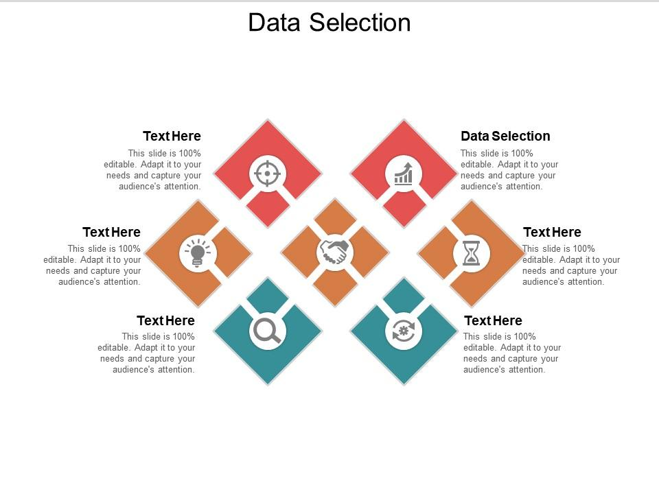

Slide 3
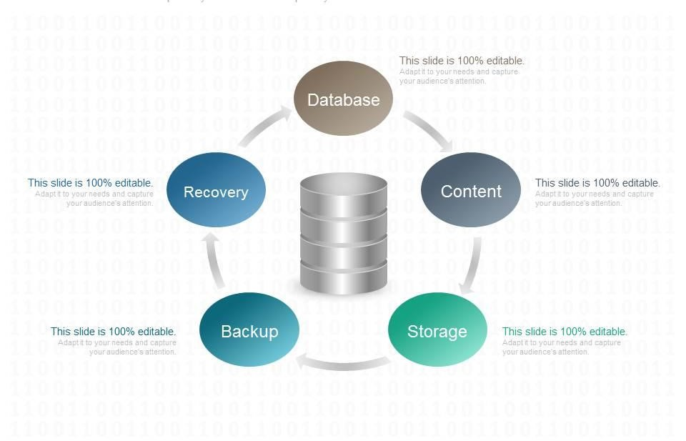
Database setup

Slide 4
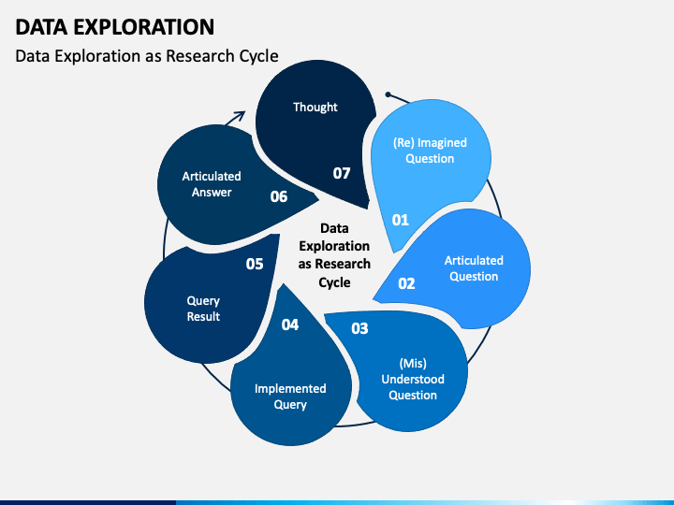

Slide 5
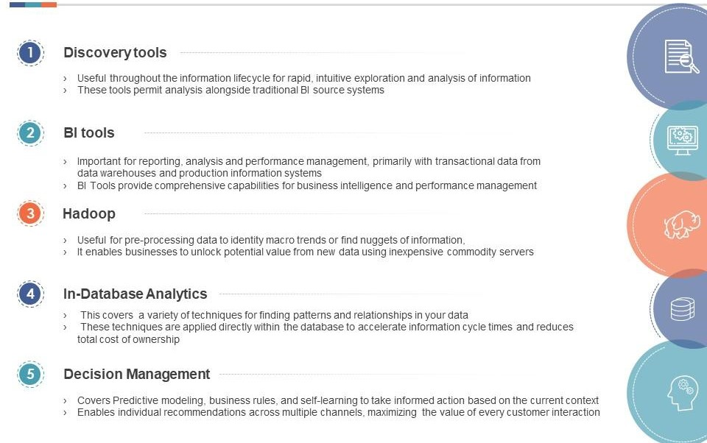
Analysis techniques

Slide 6

visualization
Big data Visualization is , as the name suggests, a visual representation of big data. Visualization techniques vary depending on the goal of the illustration. It could be as simple as line charts, histograms and pie charts or a bit complex like scatter plot, heat maps, tree maps, etc. Visualization of big data can also be done in 3-Dimensional graphs, based on the use case.

Slide 7
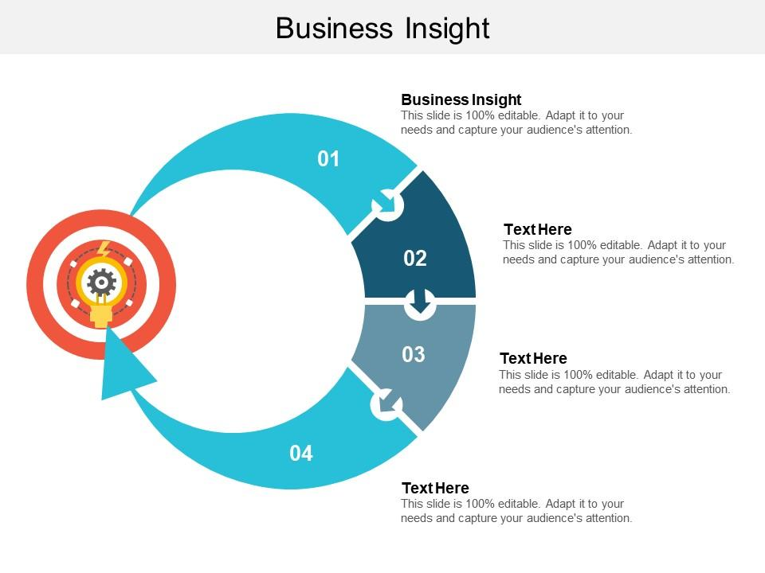

Slide 8
THE END

